Slide 1
Docker

Slide 2
Before we get started…
Docker Toolbox
Docker Quickstart Terminal
Oracle VM VirtualBox
Kitematic
docker run -it --rm -p 8888:8888 jupyter/scipy-notebook
Notes:
docker run -it --rm -p 8888:8888 jupyter/datascience-notebook
jupyter notebook --ip 0.0.0.0 --no-browser
http://127.0.0.1:8888

Slide 3
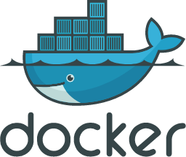
Background
Initial release on March 13, 2013
Open Source github project
Linux based
Uses container images

Slide 4
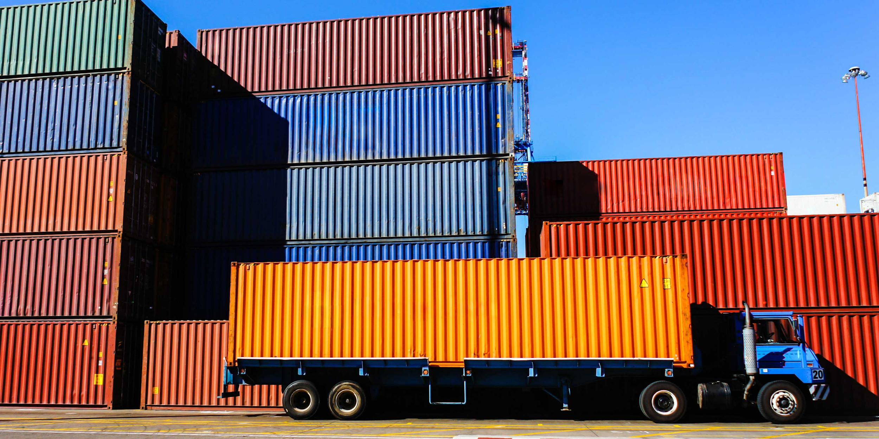
Containers
Contains everything needed to run a piece of software
Runs regardless of the environment
Isolated
Lighter than VM’s

Slide 5
Dockerhub
Comparable to github
Repositories of container images
Open to public

Slide 6
Docker for Data Science?
Saves time
Simplifies reproducibility

Slide 7
Sources
https://www.google.com/search?q=shipping+container&source=lnms&tbm=isch&sa=X&ved=0ahUKEwj7y7_aqPjZAhUI94MKHdDQD3wQ_AUICygC&biw=1396&bih=690#imgrc=CgnPMtxvl06PGM:
https://www.docker.com/what-container
https://hub.docker.com/r/jupyter/datascience-notebook/
https://towardsdatascience.com/docker-for-data-science-4901f35d7cf9

